Slide 1
House Price Prediction Project

Slide 2
Business Problem Understanding
Business Problem We are trying to Solve
Constraints
Scope
Objectives

Slide 3
Business Problem We are trying to Solve
Problems we generally face during buying a house like:
We are not aware of general factors that influence the house prices
Brokerage Fees increases the price.
Tremendous Paper work
Here, we are making predictions of the selling price of the house on the basis of the previous sold houses.
We are also making conclusion what are the factors affecting the prices of the house.

Slide 4
Constraints
Some form of interpretability.
Minimize RMSE and MAPE
Getting the Good model which will not overfit
Removal Of Multi Collinearity
Selection of Important Feature.

Slide 5
Scope
We can add more feature in the future to add them in our analysis.
In this way, We can retrain over model and there might be a possibility of getting good results.
Developing a well-integrated web application that can predict prices whenever users want it to will complete the project.

Slide 6
Objectives
Create an analytical framework to understand
Key factors impacting house price.
Develop a modelling framework
To estimate the price of a house that is up for sale

Slide 7
Data Preparation
Reading the Dataset- We have read the data and understand it and then we see the null values and some unwanted values in between the data which we removed in the next steps.
Data Cleaning
Variable transformation- Some of the variable are having type object because they contain some unwanted smbol and nan value in text format so which we replace with numpy NaN value and then converted these columns into float data type
Dealing With Missing Value- As the data contains missing values so we filled the missing values using mode for categorical variables like furnished, quality, condition, coast, ceil, sight, etc and numerical variable like price, room_bed, room_bath, living_measure, lot_measure,ceil_measure, basement, yr_built, zipcode, lat, long,living_measure15, lot_measure15, total_areawith median using fillna.

Slide 8
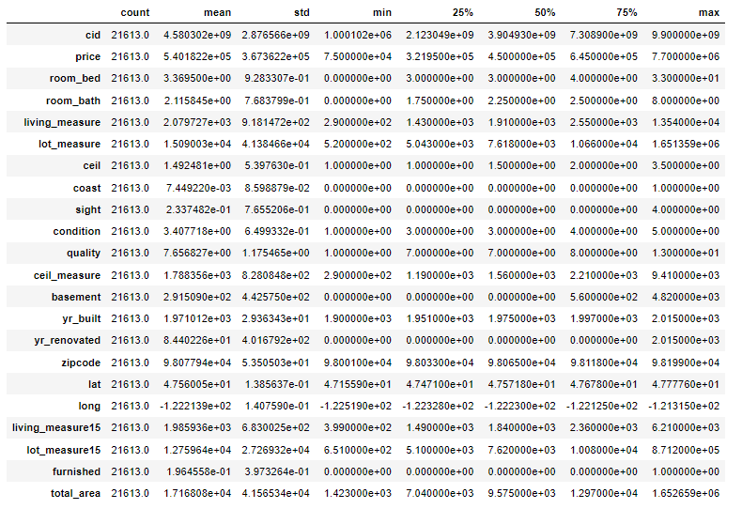
Analysis Of the Data

Slide 9
Dayhours: 5 factor analysis is reflecting for this column
price: Our taget column value is in 75k - 7700k range. As Mean > Median, it's rightly skewed.
room_bed: Number of bedrooms range from 0 - 33. As Mean slightly > Median, it's slightly rightly skewed.
room_bath: Number of bathrooms range from 0 - 8. As Mean slightly &lt; Median, it's slightly leftly skewed.
living_measure: Square footage of house range from 290 - 13,540. As Mean > Median, it's rightly skewed.
lot_measure: Square footage of lot range from 520 - 16,51,359. As Mean almost double of Median, it's Hightly rightly skewed.
ceil: Number of floors range from 1 - 3.5 As Mean ~ Median, it's almost Normal Distributed.
coast: As this value represent whether house has waterfront view or not. From above analysis we got know, very few houses has waterfront view.
sight: Value ranges from 0 - 4. As Mean > Median, it's rightly skewed
condition: Represents rating of house which ranges from 1 - 5. As Mean > Median, it's rightly skewed
quality: Representign grade given to house which range from 1 - 13. As Mean > Median, it's rightly skewed.
ceil_measure: Square footage of house apart from basement ranges in 290 - 9,410. As Mean > Median, it's rightly skewed.
basement: Square footage house basement ranges in 0 - 4,820. As Mean highlty > Median, it's Highly rightly skewed.
yr_built: House built year ranges from 1900 - 2015. As Mean &lt; Median, it's leftly skewed.
yr_renovated: House renovation year only 2015. So this column can be used as Categorical Variable for knowing whether house is renovated or not.
living_measure15: Value ragnes from 399 to 6,210. As Mean > Median, it's rightly skewed.
lot_measure15: Value ragnes from 651 to 8,71,200. As Mean highly > Median, it's Highly rightly skewed.

Slide 10
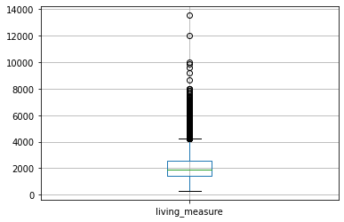
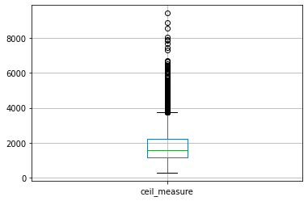
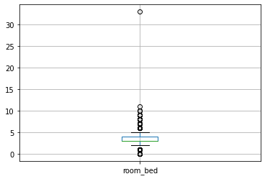
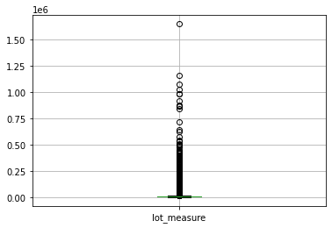
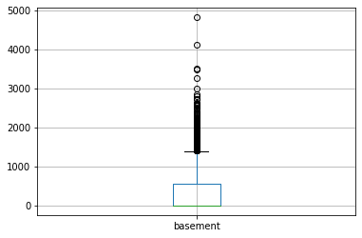
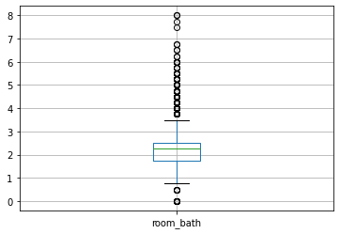
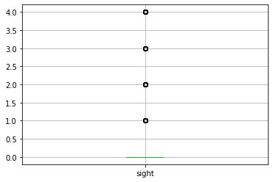
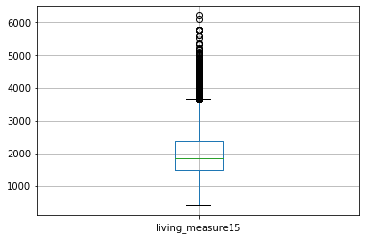
BoXplots
There are lots of feature which are having outliers.

Slide 11
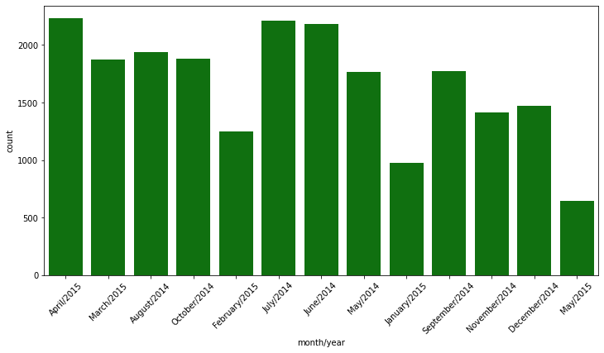
Analysis Of DayHours
We can see from the graph that in april 2015 and june and july of 2014 most houses are sold.
In the dataset, we can see the sales is high in the month of April/2015.

Slide 12
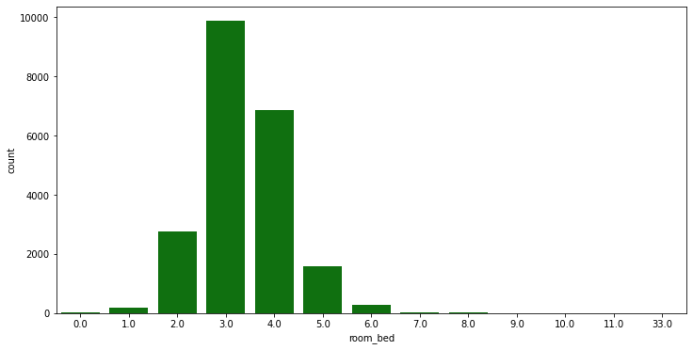
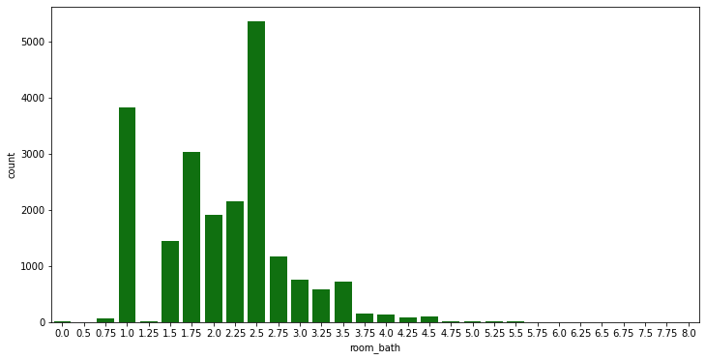
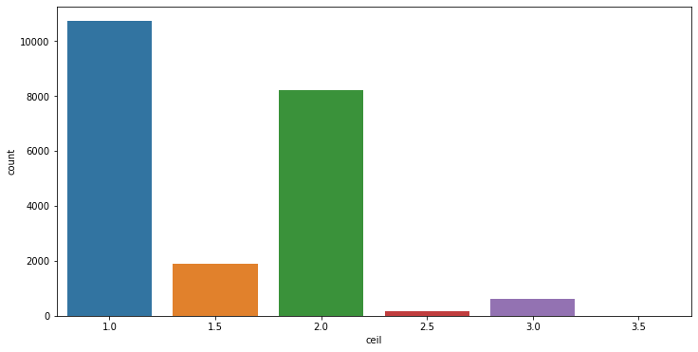
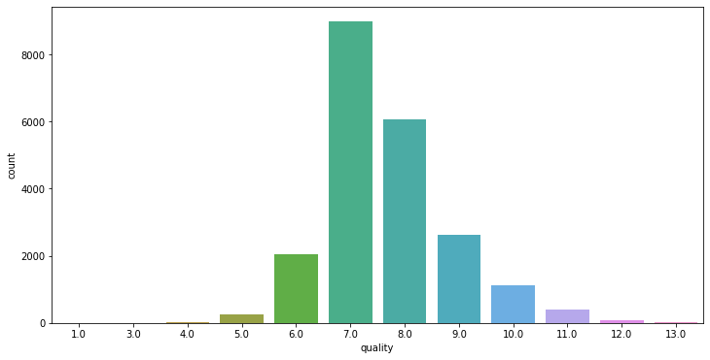
Univariant Analysis
Most of the houses have 3 or 4 bedrooms
Majority of the houses have bathroom in the range of 1.0 to 2.5
Most houses have 1 and 2 floors
Most properties have quality rating between 6 to 10

Slide 13
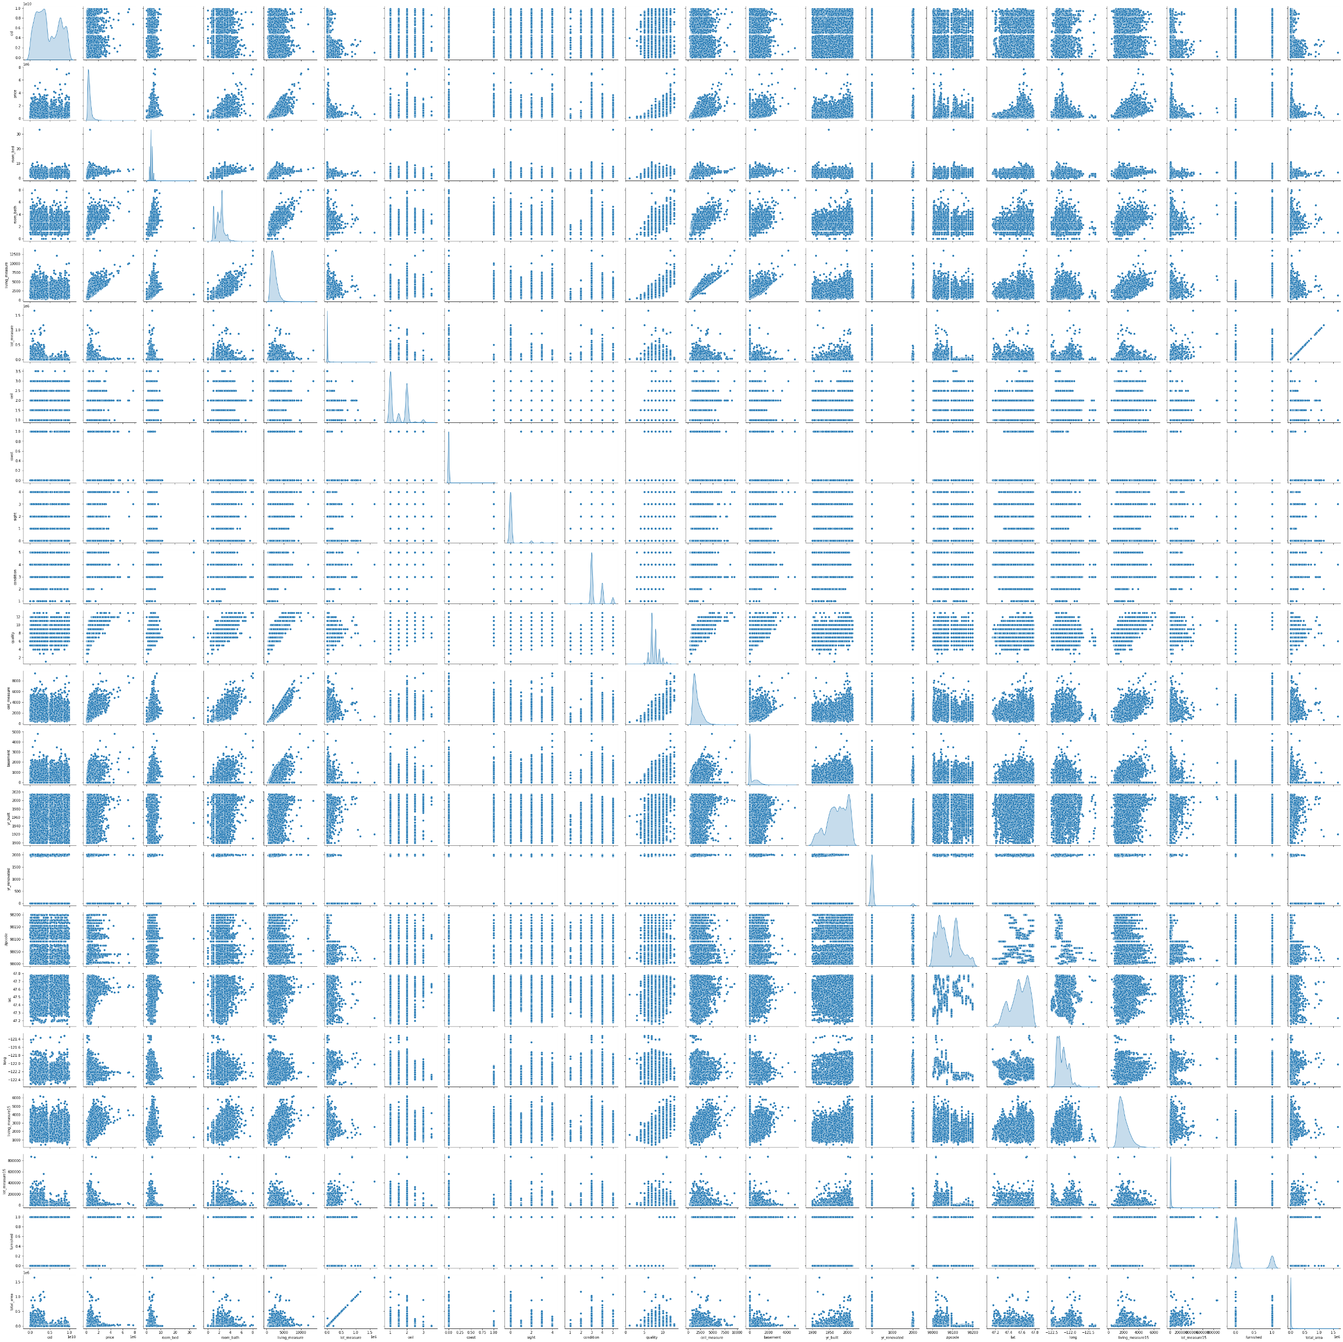
PairPlot

Slide 14
price: price distribution is Right-Skewed as we deduced earlier from our 5-factor analysis
room_bed: our target variable (price) and room_bed plot is not linear. It's distribution have lot of gaussians
room_bath: It's plot with price has somewhat linear relationship. Distribution has number of gaussians.
living_measure: Plot against price has strong linear relationship. It also have linear relationship with room_bath variable. So might remove one of these 2. Distribution is Right-Skewed.
lot_measure: No clear relationship with price.
ceil: No clear relationship with price. We can see, it's have 6 unique values only. Therefore, we can convert this column into categorical column for values.
coast: No clear relationship with price. Clearly it's categorical variable with 2 unique values.
sight: No clear relationship with price. This has 5 unique values. Can be converted to Categorical variable.
condition: No clear relationship with price. This has 5 unique values. Can be converted to Categorical variable.
quality: Somewhat linear relationship with price. Has discrete values from 1 - 13. Can be converted to Categorical variable.
ceil_measure: Strong linear relationship with price. Also with room_bath and living_measure features. Distribution is Right-Skewed.
basement: No clear relationship with price.
living_measure15: Somewhat linear relationship with target feature. It's same as living_measure. Therefore we can drop this variable.
lot_measure15: No clear relationship with price or any other feature.

Slide 15
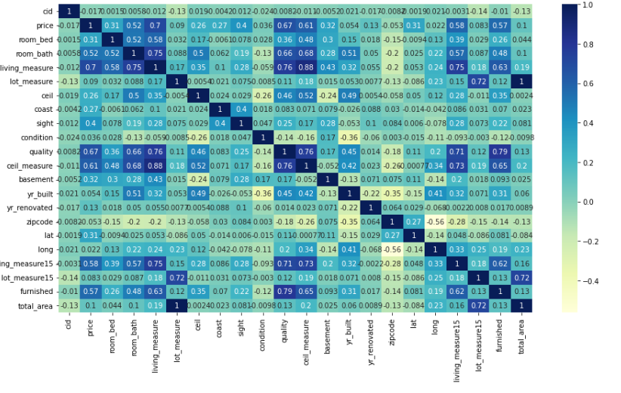
Heatmap

Slide 16
Insights -HeatMap
Here we are looking which feature can be dropped according to correlation between them.
On left the name of the column is written and on right the columns which are highly correlated with it is written.
price: room_bath, living_measure, quality, living_measure15, furnished
living_measure: price, room_bath. So we can consider dropping 'room_bath' variable.
quality: price, room_bath, living_measure
ceil_measure: price, room_bath, living_measure, quality
living_measure15: price, living_measure, quality. So we can consider dropping living_measure15 as well. As it's giving same info as living_measure.
lot_measure15: lot_measure. Therefore, we can consider dropping lot_measure15, as it's giving same info.
furnished: quality
total_area: lot_measure, lot_measure15. Therefore, we can consider dropping total_area feature as well. As it's giving same info as lot_measure.

Slide 17
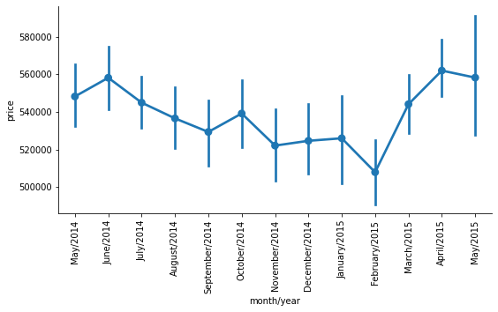
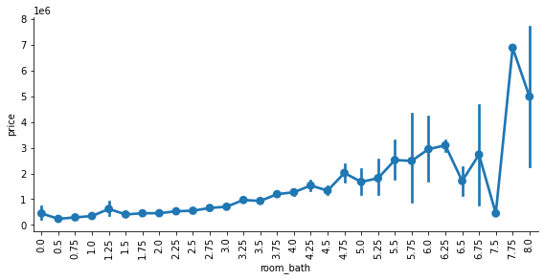
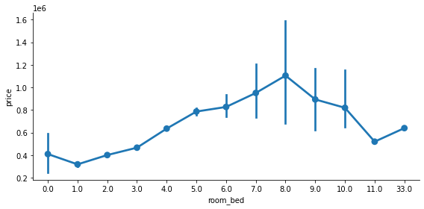
Bivariate Analysis
The mean price of the houses tend to be high during March,April, May as compared to that of September, October, November,December period.
Outliers are there. Overall mean and median price increares with increasing room_bath<br>
There is upward trend in price with increase in room_bath
There is clear increasing trend in price with room_bed

Slide 18
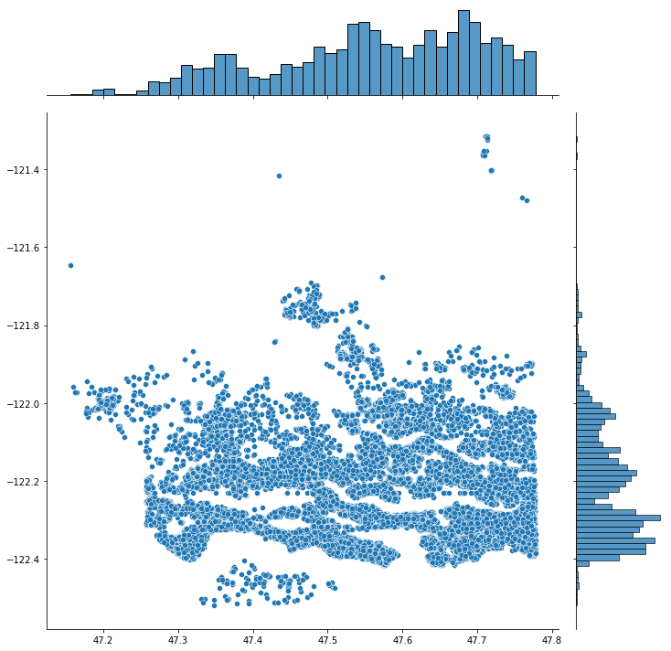
Visualizing the location of the houses based on latitude and longitude.
We can see that for latitude between -47.3 and 47.8 and for longitude between -122.0 to -122.4 there are many houses

Slide 19
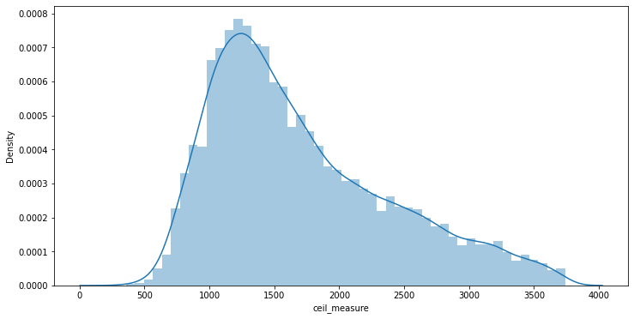
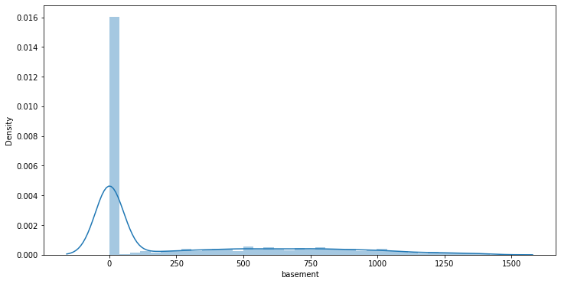
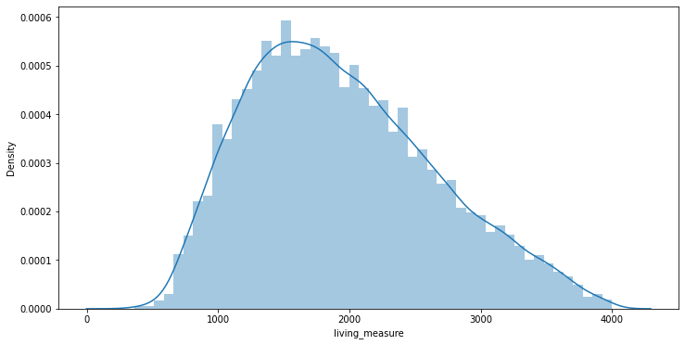
Outlier Removal
Ceil_measure- After treating outliers of ceil_measure, the data has reduced by about 600(~3%) data points but data is nicely distributed
Basements- We got 408 records as outliers. we can see that 400(~2%) data points got imputed. Total about 5% data has been imputed after treating ceil_measure and basement.
Living_measure- we lost 178 data points more and data distribution looks normal
Lot_measure- We got 2155 records which are outliers. Total outliers in the lot_measure are 2128 data points. But still we are going ahead with imputing the data

Slide 20
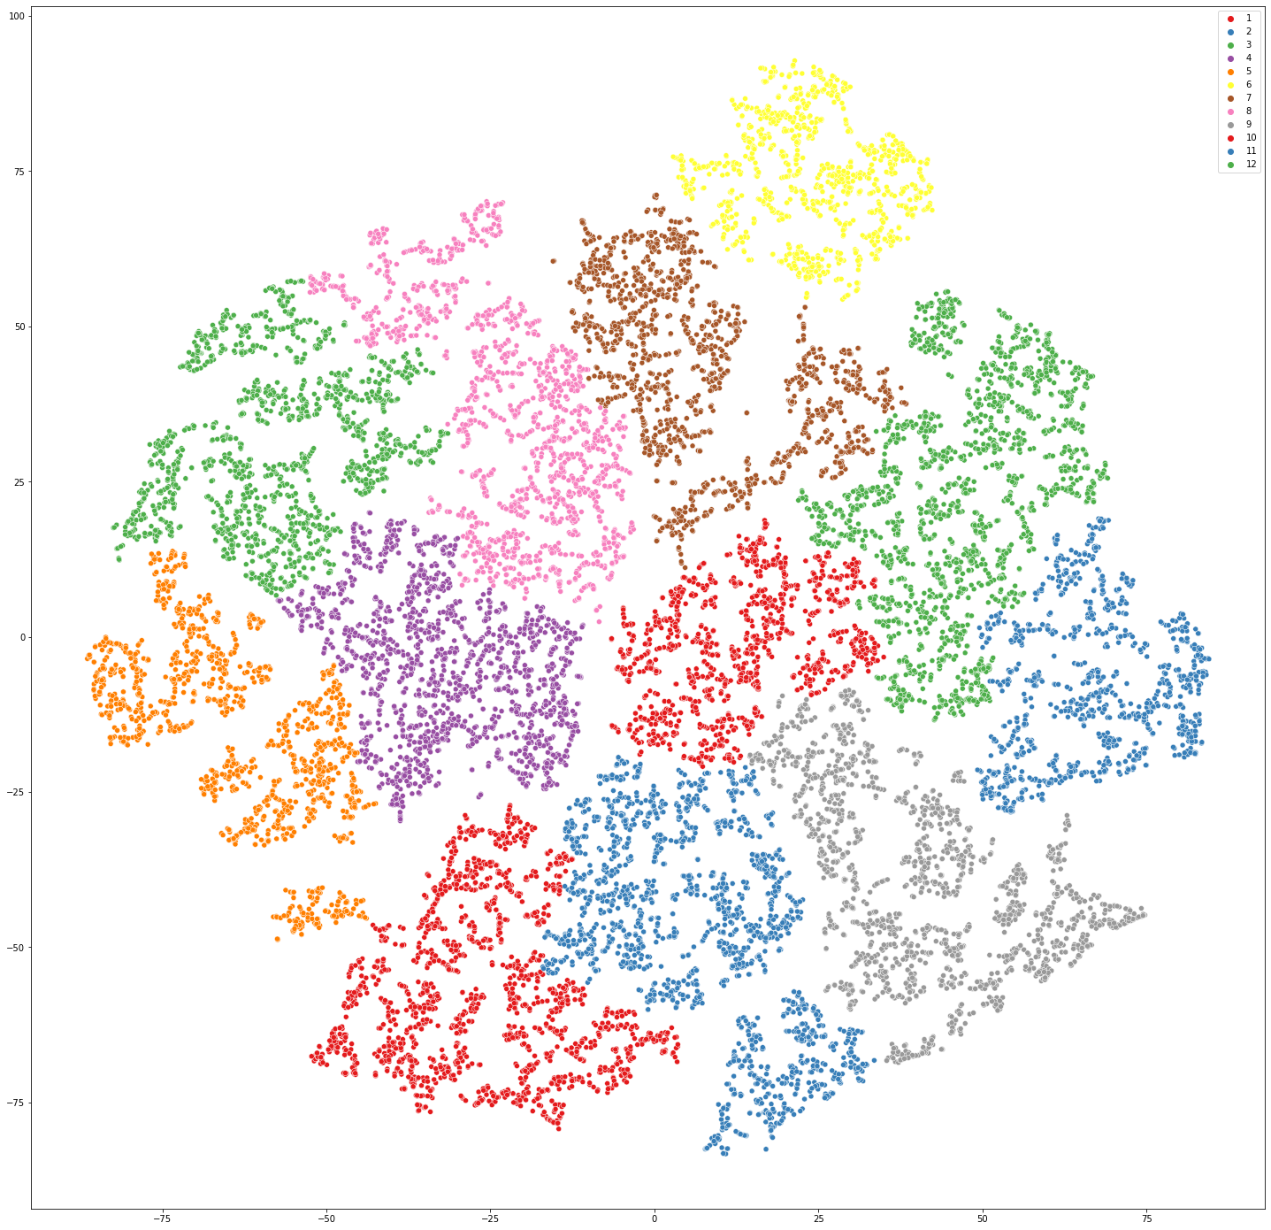
Clustering
Keeping the value of t (threshold to apply when forming flat clusters) = 1000 then we can see the small cluster on the basis of there properties we can see the number of cluster is 13

Slide 21
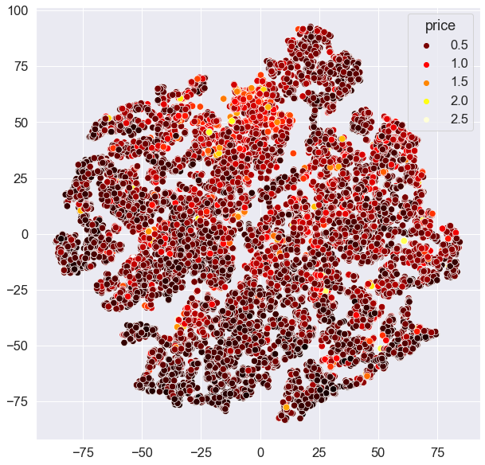
Clustering On the Basis of prices
We can see how houses are clustered on the basis of the prices

Slide 22
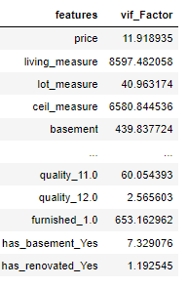
Checking fo Multi-Collinearity using VIF
We can see most of the values are greater then 10 then the data is highly corelated

Slide 23
Checking significance of variable using p value
Firstly we are performing the one hot encoding on the scaled data then we are checking the significance of each column by p-value.
These are the selected feature using p-value which we are going to use for analysis-
living_measure, lot_measure, ceil_measure, yr_built,living_measure15, lot_measure15, total_area, house_land_ratio,room_bed_1.0, room_bed_2.0, room_bed_3.0, room_bath_0.5,room_bath_0.75, room_bath_1.0, room_bath_1.25, room_bath_1.5,room_bath_1.75, room_bath_2.0, room_bath_2.25, room_bath_2.5,room_bath_2.75, room_bath_3.0, room_bath_3.25, room_bath_3.5,room_bath_3.75, room_bath_4.0, room_bath_4.25, room_bath_4.5,room_bath_4.75, room_bath_5.0, room_bath_5.25, ceil_1.5,ceil_2.5, ceil_3.0, ceil_3.5, coast_1.0, sight_1.0,sight_2.0, sight_3.0, sight_4.0, condition_2.0, condition_3.0,condition_4.0, condition_5.0, quality_4.0, quality_5.0,quality_6.0, quality_7.0, quality_8.0, quality_9.0,quality_10.0, quality_11.0, quality_12.0, has_basement_Yes,has_renovated_Yes

Slide 24
Model Approaches Used & Why
Linear Regression
Linear Regression with Lasso
Linear Regression with Ridge
Training and Testing Accuracy is very Low
RMSE is very High
Coeff of All variable is all non-zero
KNN Regressor
Support vector regressor
Decision Tree Regressor modified
Logistic Regression
Model is nor performing well
All the interpretations are coming in the range 0 to 1 only
Gradient boosting model
Got good result from the previous trained model
Bagging Regressor
Model is Overfitted
Random Forest
Model is overfitting on the training data
XGBoost
Same this Model is overfitting
ADA Boost
Overfitting is taking place
Gradient boosting model Using GridCV
With Hyperparameter tuning this model accuracy iis increased
Gradient boosting model Using RandomCV
Similarly accuracy is increased but the slight overfitting is also there
Training and Testing Accuracy is very Low
Training and Testing Accuracy is very Low
RMSE is very High
RMSE is very High
Coeff of 1 vaiable is alost zero
Accuracy is Low
Model is Overfitting in training set
Model is not learning well
Predictio is in range -5 to 0
Worrst model
Model is overfitting for Training data

Slide 25
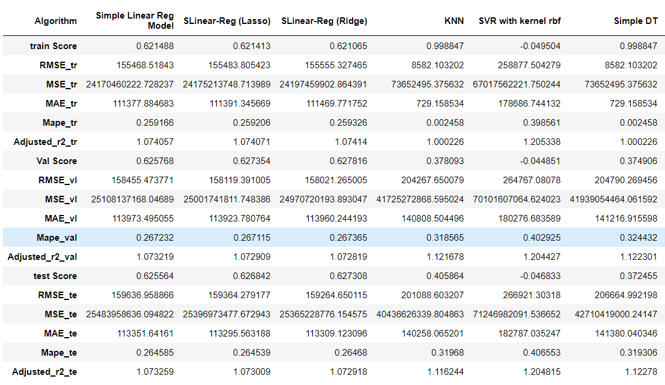
Performance Metrices

Slide 26
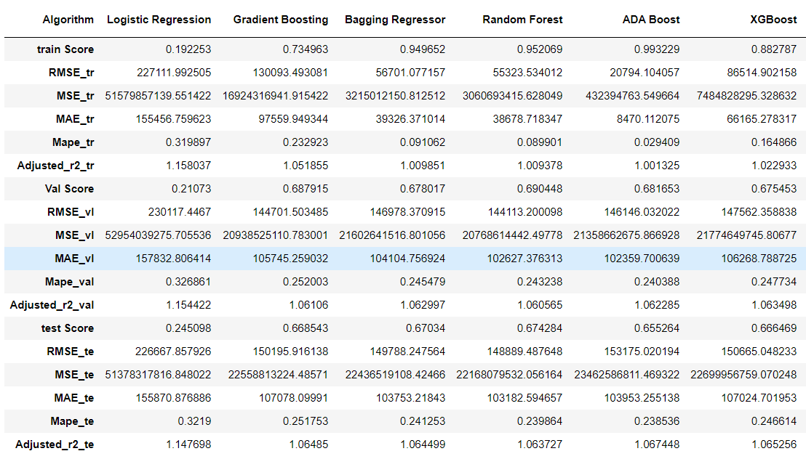
Performance Metrices

Slide 27
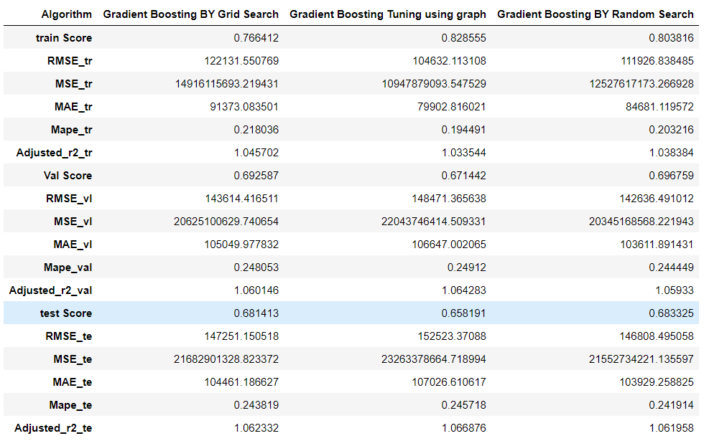
Performance Metrices – (After Hyperparameter Tuning)

Slide 28
Model Insights
The linear regression model performed with scores 0.62, 0.61 & 0.62 in training data set, validation data and test data set respectively
The lasso linear regression model performed with scores 0.62, 0.61 & 0.62 in training data set, validation data and test data set respectively. The coefficients of 1 variable in lasso model is almost '0', signifying that the variable with '0' coefficient can be dropped.
The Ridge linear regression model performed with scores 0.62, 0.61 & 0.62 in training data set, validation data and test data set respectively. The coefficients of variables in ridge model are all non-zero, indicating that non of the variables can be dropped.
Linear models have performed almost with similar results in both regularized model and non-regularized models From the graph we can also see that the over model is in ideal state as regularized model and non-regularized models
Though KNN regressor performed well in training set, the performance score in validation set is very less. This shows that the model is overfitted in training set.
Negative scores in SVR model is due to non-learning of the model in the training set which results in non-performance in validation set.
Initial Decision tree model shows overfit in training set with 0.99 score and low performance in validation and test set. It is not the ideal solution.
Decision tree model with modified parameter has better performed on the training set and validation set compared to initial decision tree model. But overall decision tree has not performed well than linear regression models.
The Logistic regression model with modified parameters has not performed well with just ~0.22 in training tesing and validation data sets.

Slide 29
Model Insights
Gradient boosting model has provided good scores in both training and validation sets
Bagging model also performed well in training and validation sets. There seems to be overfitting in training set. We need to analyze further by hyper tuning
Random forest model has performed fine not that much good. There is scope of further analysis on this model. But the overfitting is taken place which is not good.
Ensemble models: in summary ensemble models have performed well on training and validation sets. These models will be selected for further analysis with hyper tuning and feature selection
Ada Boost model has performed fine not that much good. There is scope of further analysis on this model. But the overfitting is taken place which is not good.
XGBoost has performed fine not that much good. There is scope of further analysis on this model. But the overfitting is taken place which is not good.
Ensemble methods are performing better than linear models.
Of all the ensemble models, Gradient boosting regressor is giving better R2 score.
We identified top 30 features that are explaining the 95% variation in model(Random Forest). Will further hyper tune the model to improve the model performance. Will further explore and evaluate the features while hyper turning the ensemble models

Slide 30
Recommendations
Classification algorithms can be used to predict if a house is near a coastal area.
Clustering algorithms can be used to identify similar neighbors
Machine learning algorithms can predict the value of a building or asset over the next decade, based on data from the last few years. You can see exactly how much profit you will get in the next 10 years. !!
Using machine learning algorithms in recommender systems helps buyers find property details and unique insights of it.

Slide 31
Conclusion
We can conclude from above that GridSearchCV is giving better results compared to that of tuning done by graphical method of individual parameters or RandomSearchCV
The ensemble models have performed well compared to that of linear,KNN,SVR models, logistic
The best performance is given by Gradient boosting model
The top key features that drive the price of the property are: 'furnished_1', 'yr_built', 'living_measure','quality_8', 'HouseLandRatio', 'lot_measure15', 'quality_9', 'ceil_measure', 'total_area'
The above data is also reinforced by the analysis done during bivariate analysis.

